Slide 1
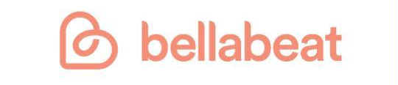
How Can a Wellness Technology Company Play It Smart?
Google Data Analytics Case Study by Yina Qiao
File created on: 7/3/2022

Slide 2
Business Task
Bellabeat, a high-tech manufacturer of health-focused products for women.
The task is to analyze smart device usage data in order to reveal new growth opportunities for Bellabeat. Looking at these trends to provide recommendations for Bellabeat marketing strategy.

Slide 3
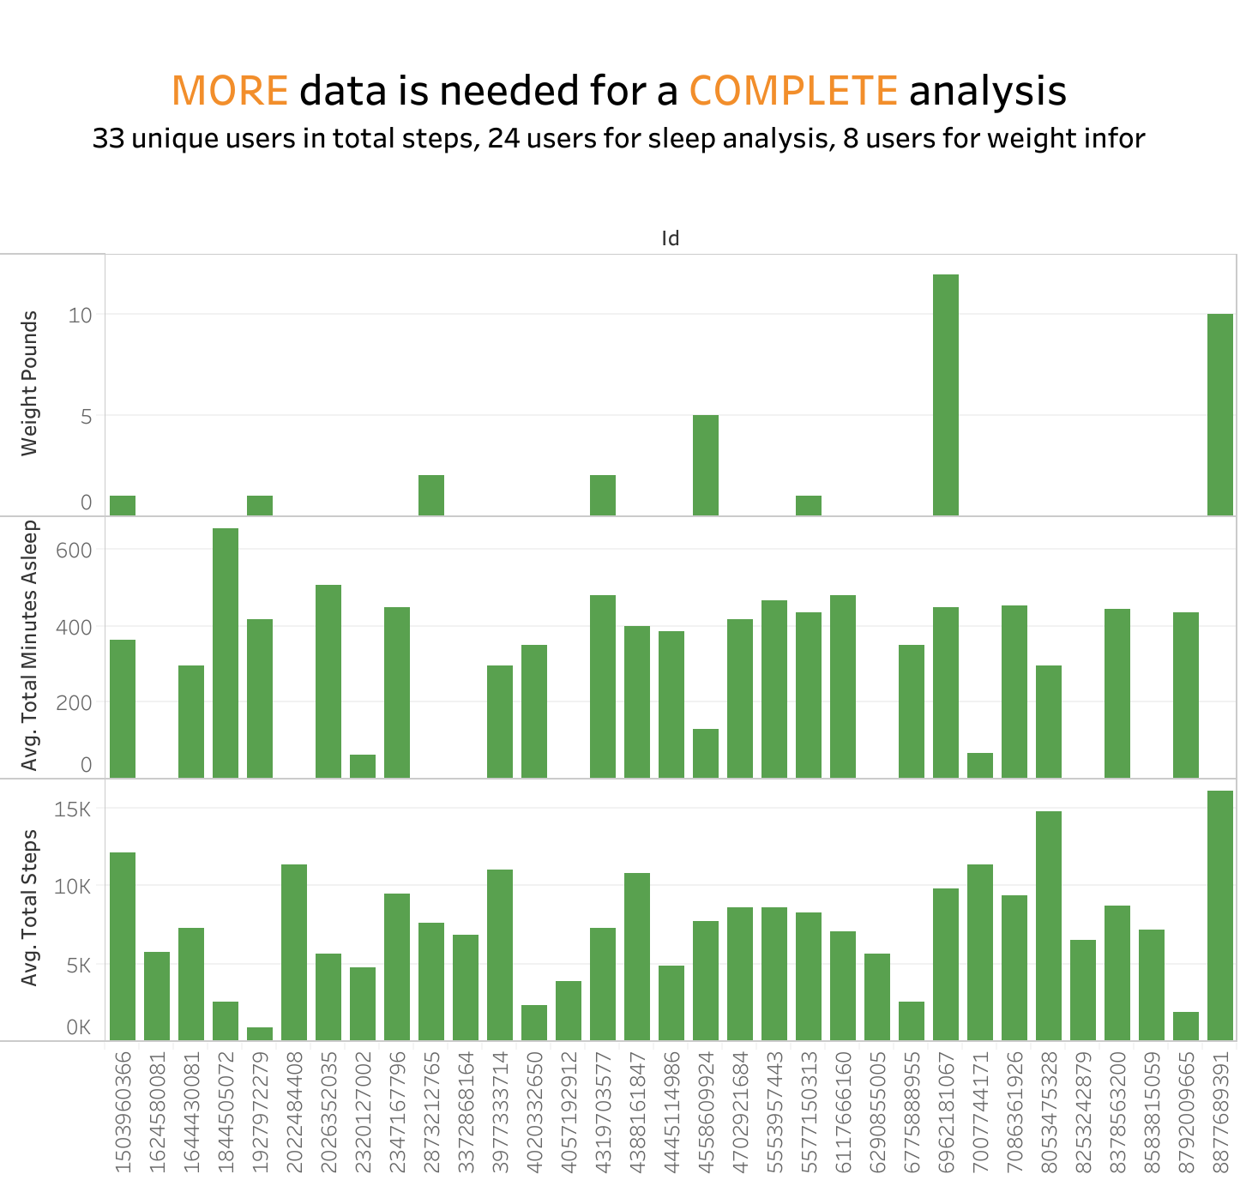

Slide 4
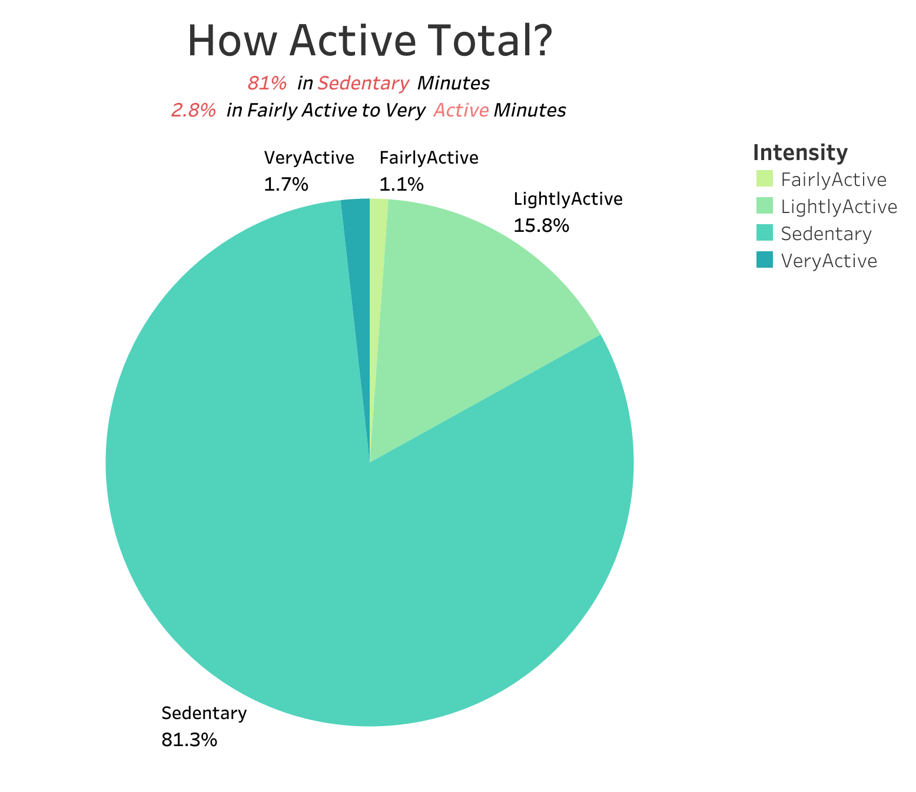

Slide 5
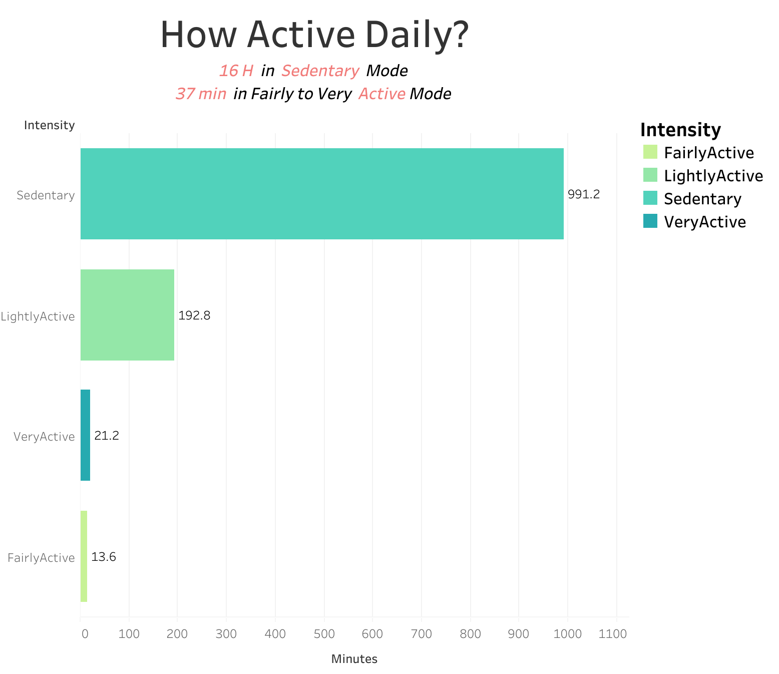

Slide 6
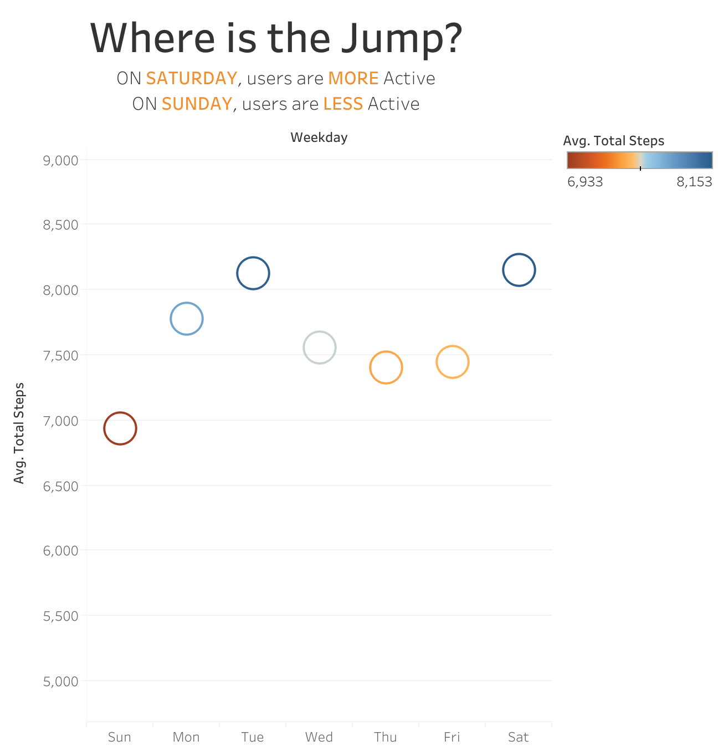

Slide 7
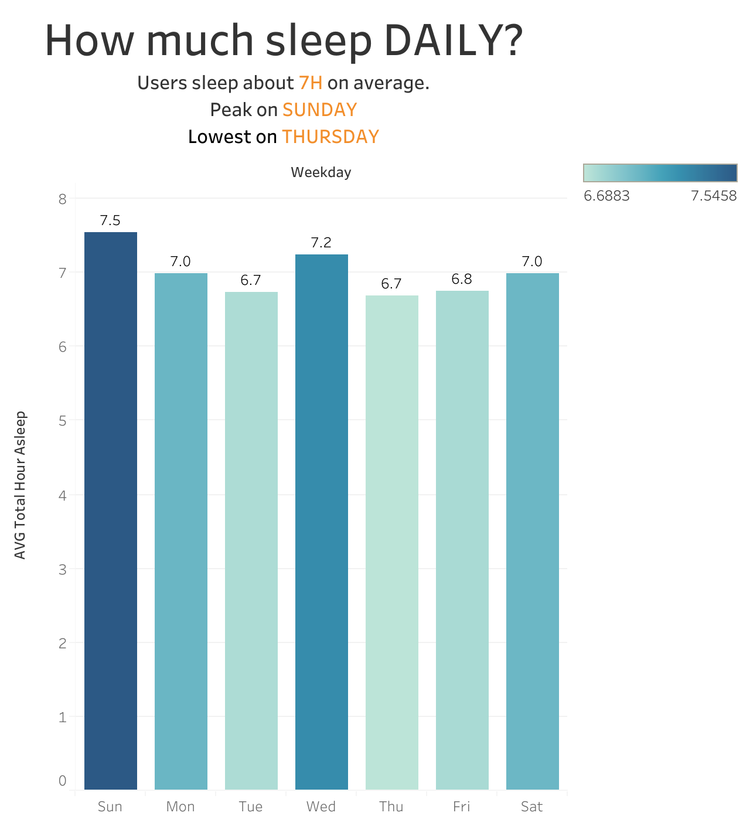

Slide 8
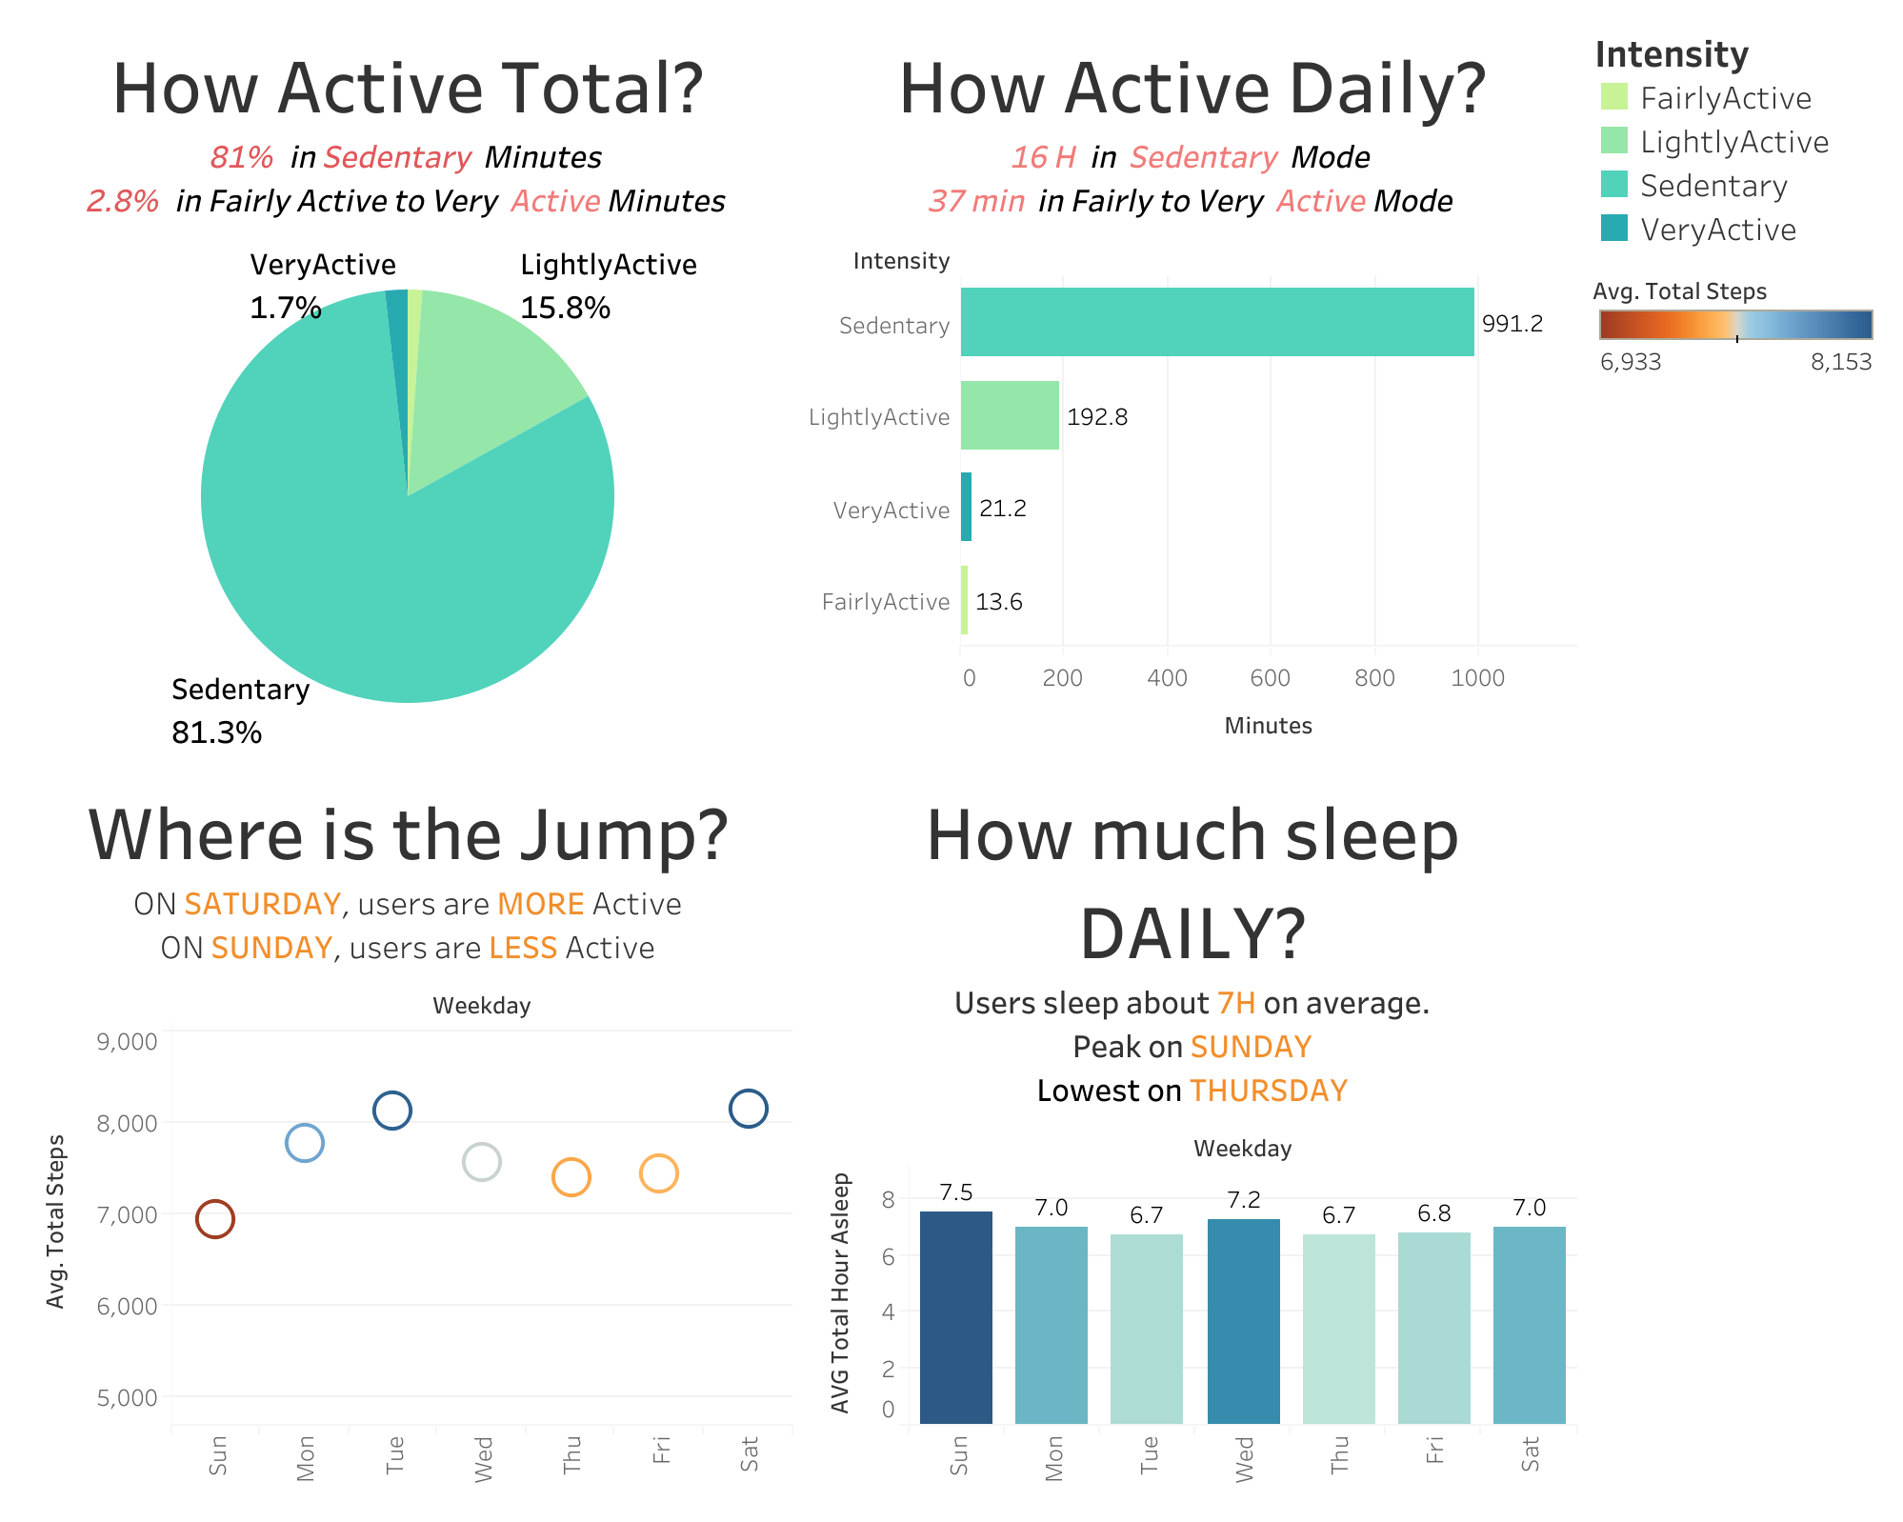

Slide 9
Recommendations
Timely notifications: in the Bellebeat app/Leaf/Time, when sensing a prolonged period of sedentary minutes, signaling it’s time to get active.
Lifestyle campaign: to promote a healthy active lifestyle by recommending user short exercises during the week and longer exercises on weekend, especially on Sunday.
Rewards program: to incentivize users to complete the entire week exercise, showcasing the calories user burned, reward points can be redeemed towards product/subscriptions.
Auto sleep notification: tracking user sleep trends to remind and encourage user to maintain good 7h sleep especially on Tuesday and Thursday.
Obtain more data for accurate analysis

